Slide 1


<Anish Kundu>
<Date: 18-06-2025>

Slide 2

Outline
Executive Summary
Introduction
Methodology
Results
Conclusion
Appendix

Slide 3
Executive Summary
Summary of methodologies : Extracted data from the public SpaceX API and official Wikipedia sources. Engineered a target label column, ‘class’, to indicate successful landings. Conducted data exploration through SQL queries, visualizations, interactive Folium maps, and dashboard tools. Selected and refined relevant feature columns, applied one-hot encoding to convert categorical variables into binary format, and standardized the dataset. Leveraged GridSearchCV to optimize hyperparameters across various machine learning models and visualized their accuracy scores for comparative analysis..
Summary of all results : Four machine learning models were produced: Logistic Regression, Support Vector Machine, Decision Tree Classifier, and K Nearest Neighbors. All produced similar results with accuracy rate of about 83.33%. All models over predicted successful landings. More data is needed for better model determination and accuracy.

Slide 4
Introduction
Background:
Commercial Space Age is Here
Space X has best pricing ($62 million vs. $165 million USD)
Largely due to ability to recover part of rocket (Stage 1)
Space Y wants to compete with Space
Problem:
Space Y tasks us to train a machine learning model to predict successful Stage 1 recovery
How does launch site or payload mass impact landing success?

Slide 5

Section 1

Slide 6
Methodology
Executive Summary
Data collection methodology:
Combined data from SpaceX public API and SpaceX Wikipedia page
Perform data wrangling
Classifying true landings as successful and unsuccessful otherwise
Perform exploratory data analysis (EDA) using visualization and SQL
Perform interactive visual analytics using Folium and Plotly Dash
Perform predictive analysis using classification models
Tuned models using GridSearchCV

Slide 7
Data Collection
Data collection process involved a combination of API requests from Space X public API and web scraping data from a table in Space X’s Wikipedia entry.
The next slide will show the flowchart of data collection from API and the one after will show the flowchart of data collection from webscraping.
Space X API Data Columns:
FlightNumber, Date, BoosterVersion, PayloadMass, Orbit, LaunchSite, Outcome, Flights, GridFins,
Reused, Legs, LandingPad, Block, ReusedCount, Serial, Longitude, Latitude
Wikipedia Webscrape Data Columns:
Flight No., Launch site, Payload, PayloadMass, Orbit, Customer, Launch outcome, Version Booster, Booster landing, Date, Time

Slide 8
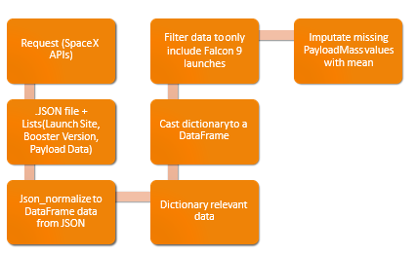
Data Collection – SpaceX API

Slide 9
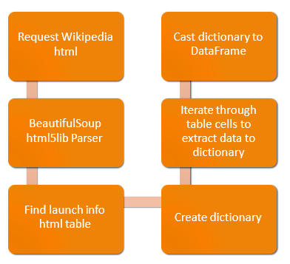
Data Collection - Scraping

Slide 10
Data Wrangling
Create a training label with landing outcomes where successful = 1 & failure = 0.
Outcome column has two components: ‘Mission Outcome’ ‘Landing Location’
New training label column ‘class’ with a value of 1 if ‘Mission Outcome’ is True and 0 otherwise. Value Mapping:
True ASDS, True RTLS, & True Ocean – set to -> 1
None None, False ASDS, None ASDS, False Ocean, False RTLS – set to -> 0
GitHub url: https://github.com/AnishKundu28/IBM-Data-Science

Slide 11
EDA with Data Visualization
Exploratory Data Analysis performed on variables Flight Number, Payload Mass, Launch Site, Orbit, Class and Year.
Plots Used:
Flight Number vs. Payload Mass, Flight Number vs. Launch Site, Payload Mass vs. Launch Site, Orbit vs. Success Rate, Flight Number vs. Orbit, Payload vs Orbit, and Success Yearly Trend
Scatter plots, line charts, and bar plots were used to compare relationships between variables to
decide if a relationship exists so that they could be used in training the machine learning model
Github url: https://github.com/AnishKundu28/IBM-Data-Science

Slide 12
EDA with SQL
Loaded data set into IBM DB2 Database.
Queried using SQL Python integration.
Queries were made to get a better understanding of the dataset.
Queried information about launch site names, mission outcomes, various pay load sizes of customers and booster versions, and landing outcomes

Slide 13
Build an Interactive Map with Folium
Folium maps mark Launch Sites, successful and unsuccessful landings, and a proximity example to key locations: Railway, Highway, Coast, and City.
This allows us to understand why launch sites may be located where they are. Also visualizes successful landings relative to location.

Slide 14
Build a Dashboard with Plotly Dash
Dashboard includes a pie chart and a scatter plot. Pie chart can be selected to show distribution of successful landings across all launch sites and can be selected to show individual launch site success rates. Scatter plot takes two inputs: All sites or individual site and payload mass on a slider between 0 and 10000 kg. The pie chart is used to visualize launch site success rate. The scatter plot can help us see how success varies across launch sites, payload mass, and booster version category.

Slide 15
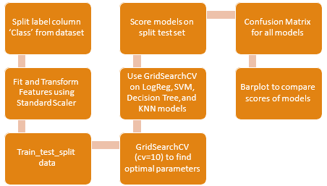
Predictive Analysis (Classification)

Slide 16
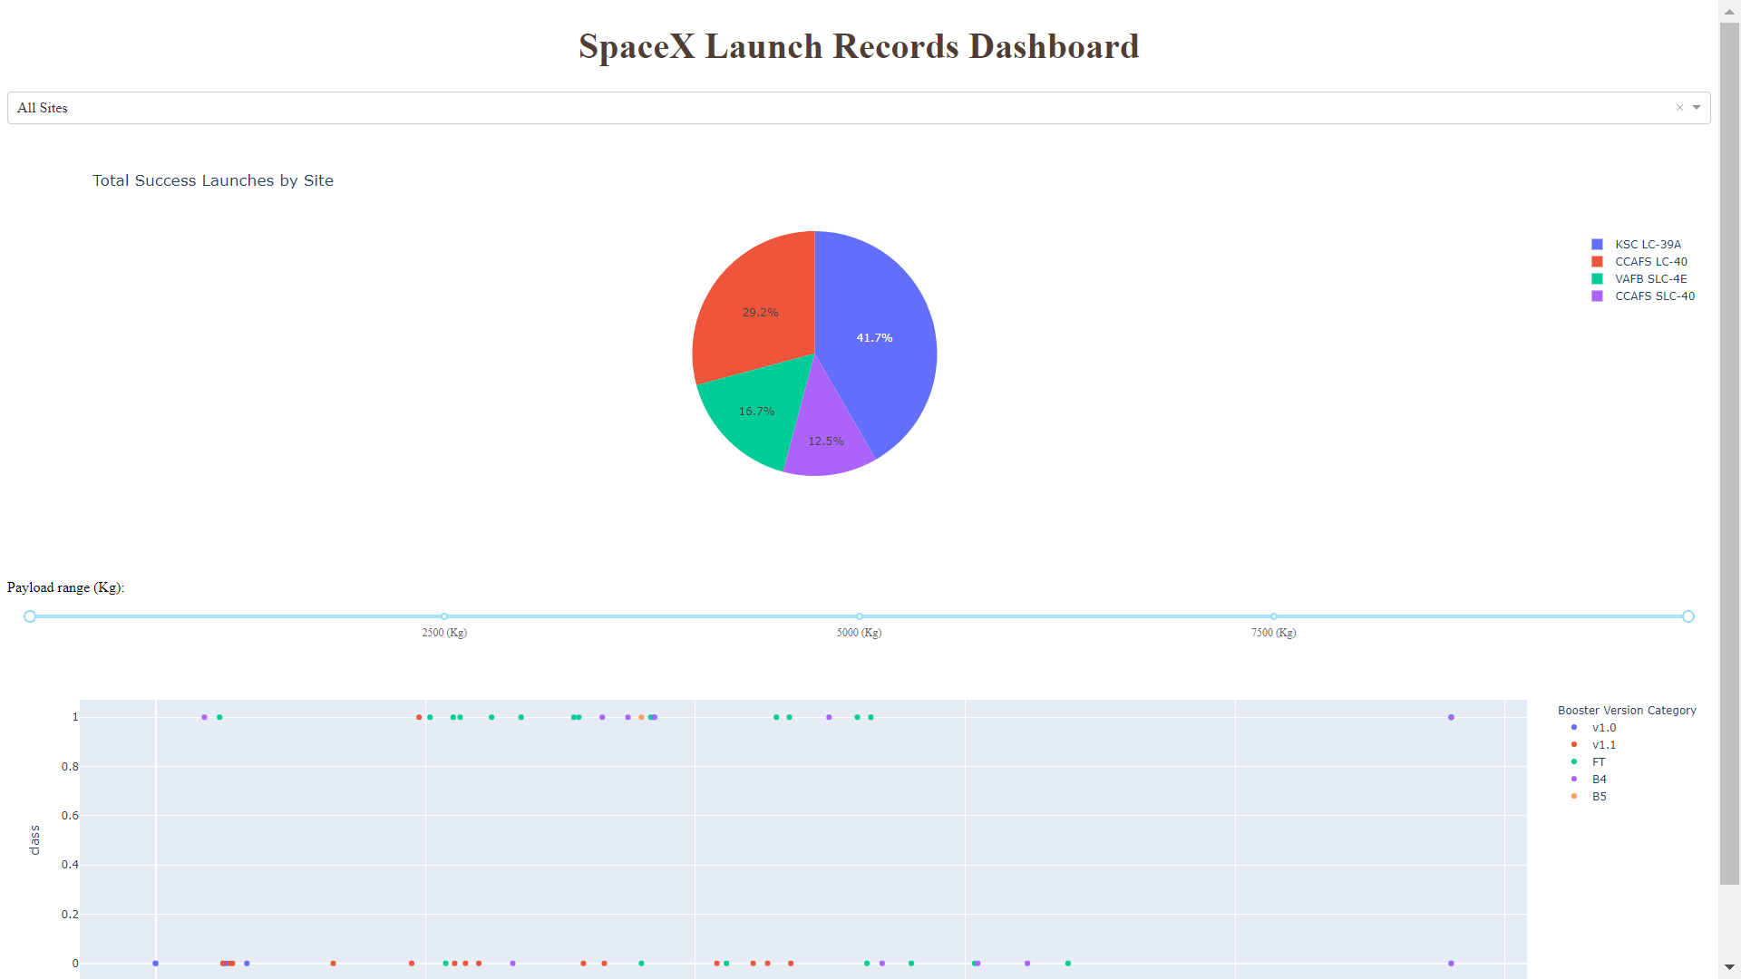
Results

Slide 17

Section 2

Slide 18
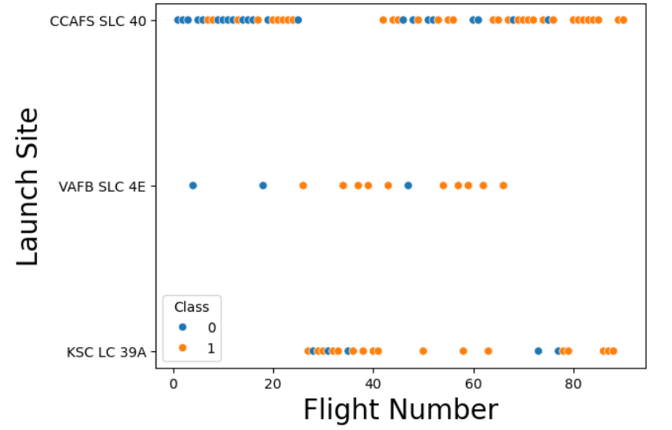
Flight Number vs. Launch Site
The scatterplot you see visualizes the relationship between FlightNumber and LaunchSite, with the points colored based on the Class variable (which represents whether the first stage landed successfully or not).
Here's what you can observe from the plot:
X-axis (Flight Number): Represents the chronological order of the Falcon 9 launches.
Y-axis (Launch Site): Shows the different locations from which the rockets were launched.

Slide 19
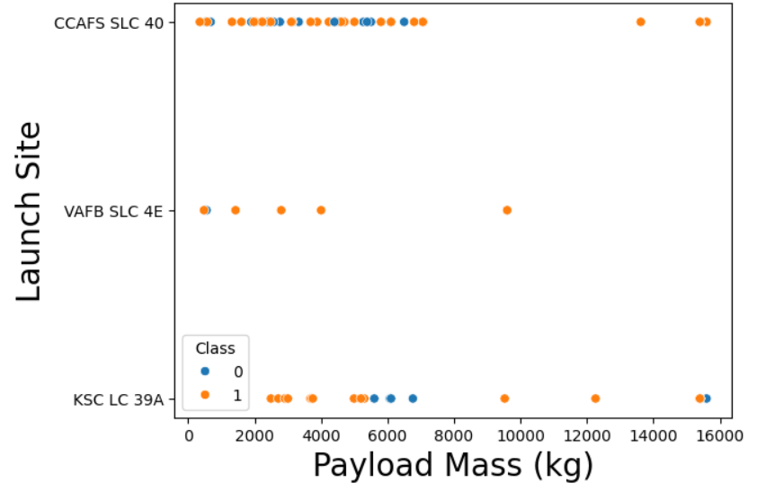
Payload vs. Launch Site
Green indicates successful launch; Purple indicates unsuccessful launch.

Slide 20
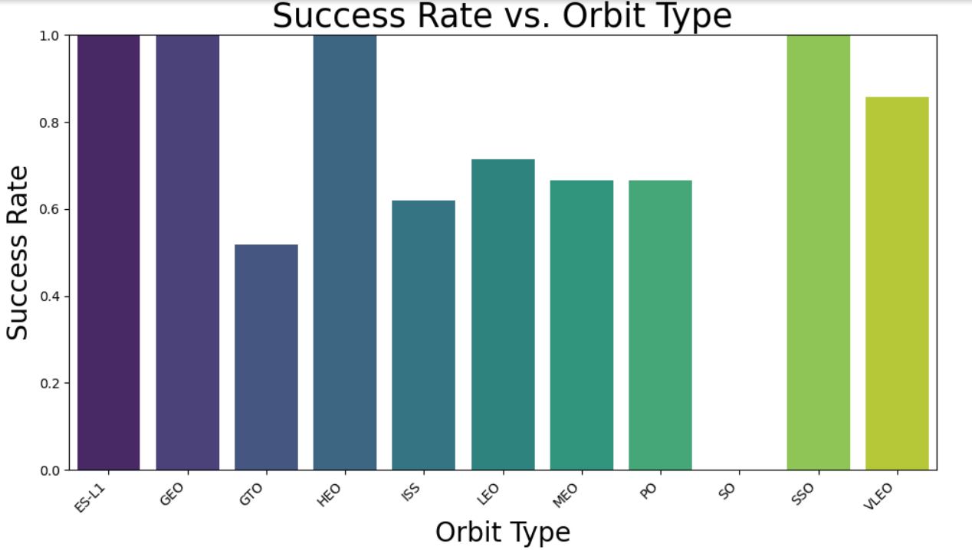
Success Rate vs. Orbit Type

Slide 21
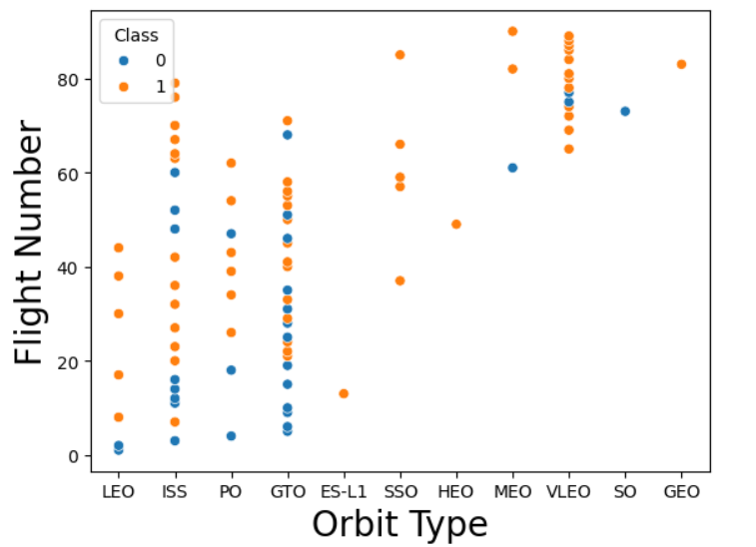
Flight Number vs. Orbit Type

Slide 22
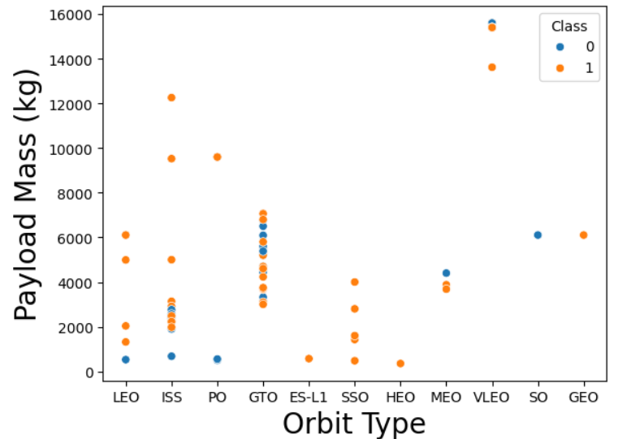
Payload vs. Orbit Type

Slide 23
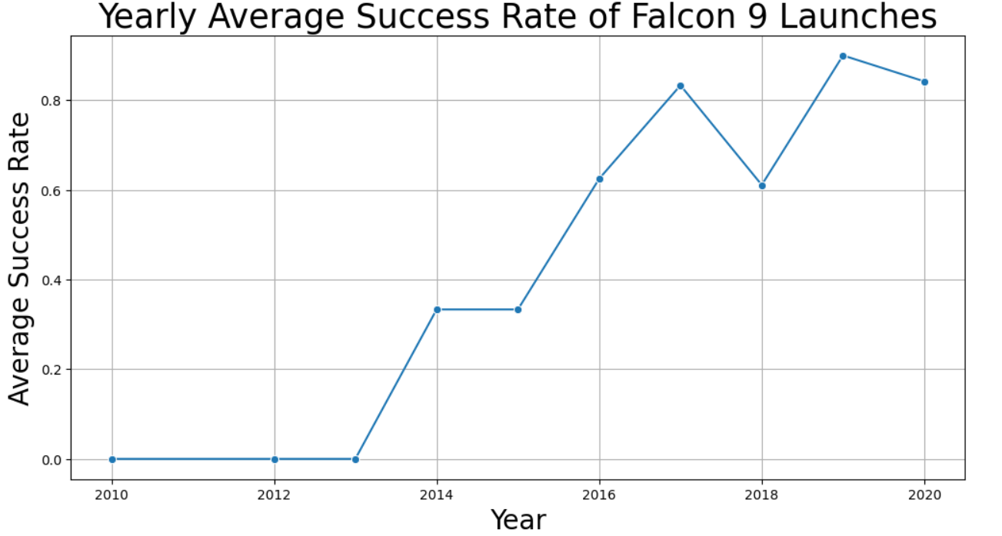
Launch Success Yearly Trend

Slide 24
All Launch Site Names
Unique Launch Sites and Explanation: -
CCAFS SLC 40: Cape Canaveral Space Force Station Space Launch Complex 40, Florida.
VAFB SLC 4E: Vandenberg Space Force Base Space Launch Complex 4E, California.
KSC LC 39A: Kennedy Space Center Launch Complex 39A, Florida.

Slide 25

Launch Site Names Begin with 'CCA'

Slide 26

Total Payload Mass
This query sums the total payload mass in kg where NASA was the customer.
CRS stands for Commercial Resupply Services which indicates that these payloads were sent to the International Space Station (ISS).

Slide 27
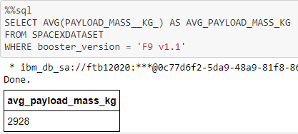
Average Payload Mass by F9 v1.1
This query calculates the average payload mass or launches which used booster version F9 v1.1
Average payload mass of F9 1.1 is on the low end of our payload mass range

Slide 28

First Successful Ground Landing Date
This query returns the first successful ground pad landing date.
First ground pad landing wasn’t
until the end of 2015.
Successful landings in general
appear starting 2014.

Slide 29

Successful Drone Ship Landing with Payload between 4000 and 6000
This query returns the four booster versions that had successful drone ship landings and a payload mass between 4000 and 6000 noninclusively.

Slide 30
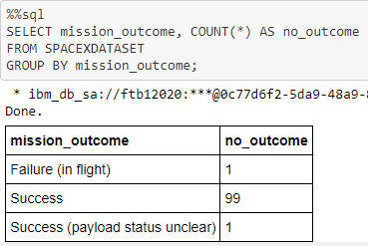
Total Number of Successful and Failure Mission Outcomes
This query returns a count of each
mission outcome.
SpaceX appears to achieve its mission outcome nearly 99% of the time.
This means that most of the landing
failures are intended.
Interestingly, one launch has an unclear payload status and unfortunately one failed in flight.

Slide 31
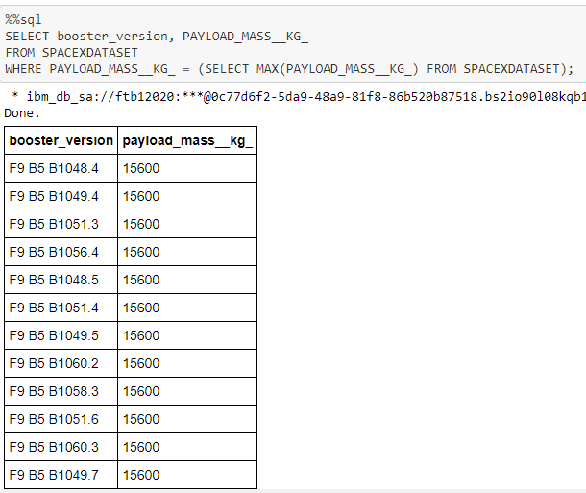
Boosters Carried Maximum Payload
This query returns the booster versions that carried the highest payload mass of 15600 kg.
These booster versions are very similar and all are of the F9 B5 B10xx.x variety.
This likely indicates payload mass correlates with the booster version that is used.

Slide 32
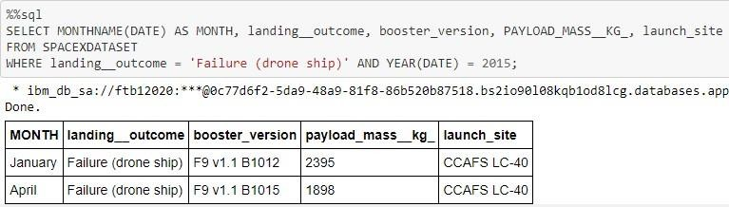
2015 Launch Records
This query returns the Month, Landing Outcome, Booster Version, Payload Mass (kg), and Launch site of 2015 launches where stage 1 failed to land on a drone ship.
There were two such occurrences.

Slide 33
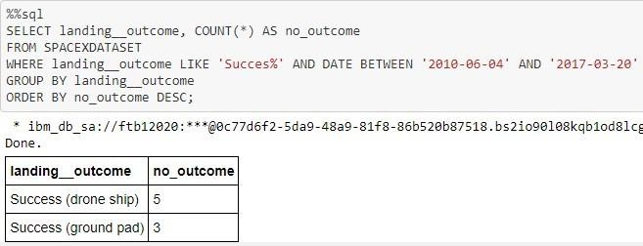
Rank Landing Outcomes Between 2010-06-04 and 2017-03-20
Rank the count of landing outcomes (such as Failure (drone ship) or Success (ground pad)) between the date 2010-06-04 and 2017-03-20, in descending order
Present your query result with a short explanation here

Slide 34

Section 3

Slide 35

Color-Coded Launch Markers
Clusters on Folium map can be clicked on to display each successful landing (green icon) and failed
landing (red icon). In this example VAFB SLC-4E shows 4 successful landings and 6 failed landings.

Slide 36

Launch Site Locations
The left map shows all launch sites relative US map. The right map shows the two Florida launch sites since they are very close to each other. All launch sites are near the ocean.

Slide 37


Key Location Proximities
Using KSC LC-39A as an example, launch sites are very close to railways for large part and supply transportation. Launch sites are close to highways for human and supply transport. Launch sites are also close to coasts and relatively far from cities so that launch failures can land in the sea to avoid rockets falling on densely populated areas.

Slide 38

Section 4

Slide 39
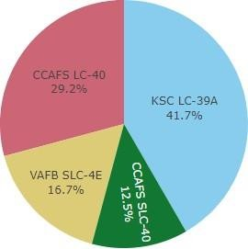
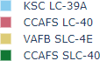
Successful Launches Across Launch Sites
This is the distribution of successful landings across all launch sites. CCAFS LC-40 is the old name of CCAFS SLC-40 so CCAFS and KSC have the same amount of successful landings, but a majority of the successful landings where performed before the name change. VAFB has the smallest share of successful landings. This may be due to smaller sample and increase in difficulty of launching in the west coast.

Slide 40
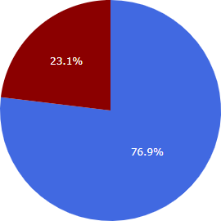
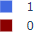

Highest Success Rate Launch Site
KSC LC-39A has the highest success rate with 10 successful landings and 3 failed landings.

Slide 41

Payload Mass vs. Success vs. Booster Version Category
Plotly dashboard has a Payload range selector. However, this is set from 0-10000 instead of the max Payload of 15600. Class indicates 1 for successful landing and 0 for failure. Scatter plot also accounts for booster version category in color and number of launches in point size. In this particular range of 0-6000, interestingly there are two failed landings with payloads of zero kg.

Slide 42

Section 5

Slide 43
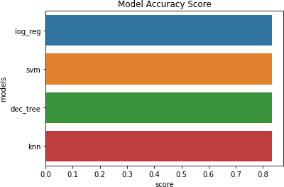
Classification Accuracy
All models had virtually the same accuracy on the test set at 83.33% accuracy. It should be noted that test size is small at only sample size of 18.
This can cause large variance in accuracy results, such as those in Decision Tree Classifier model in repeated runs.
We likely need more data to determine the best model.

Slide 44

Confusion Matrix
Since all models performed the same for the test set, the confusion matrix is the same across all models. The models predicted 12 successful landings when the true label was successful landing.
The models predicted 3 unsuccessful landings when the true label was unsuccessful landing.
The models predicted 3 successful landings when the true label was unsuccessful landings (false positives). Our models over predict successful landings.
Correct predictions are on a diagonal from top left to bottom right.

Slide 45
Conclusions
Our task: to develop a machine learning model for Space Y who wants to bid against SpaceX
The goal of model is to predict when Stage 1 will successfully land to save ~$100 million USD
Used data from a public SpaceX API and web scraping SpaceX Wikipedia page
Created data labels and stored data into a DB2 SQL database
Created a dashboard for visualization
We created a machine learning model with an accuracy of 83%
Allon Mask of SpaceY can use this model to predict with relatively high accuracy whether a launch will have a successful Stage 1 landing before launch to determine whether the launch should be made or not
If possible more data should be collected to better determine the best machine learning model and improve accuracy

Slide 46
Appendix
Github Repository url:
https://github.com/AnishKundu28/IBM-Data-Science/tree/main
Instructors:
Instructors: Rav Ahuja, Alex Aklson, Aije Egwaikhide, Svetlana Levitan, Romeo Kienzler, Polong Lin, Joseph Santarcangelo, Azim Hirjani, Hima Vasudevan, Saishruthi Swaminathan, Saeed Aghabozorgi, Yan Luo
Special Thanks to All Instructors:
https://www.coursera.org/professional-certificates/ibm-data-science?#instructors

Slide 47


